Slide 1
Grassroots Advocacy 101
August 2, 2021
MENTOR Government Relations Team

Slide 2
Agenda

Slide 3
Agenda
Why Advocate?
Advocacy Tactics
Opportunities to Engage
Congressional Staff Q+A

Slide 4
Why Advocate?

Slide 5
Why Advocate?
Community and systems-level change requires public policy
Policy impacts nonprofits’ abilities to complete their mission
Volunteers want to be engaged in making a meaningful difference
Advocacy is how we enact social change.
Notes:
Community and systems-level change requires public policy
Policy is already impacting (hurting or harming) nonprofits’ abilities to improve lives
Volunteers and donors (esp. millennials) want to be engaged in making a meaningful difference

Slide 6
Types of Advocacy
Public awareness/education
Lobbying
Grassroots advocacy/organizing

Slide 7
MENTOR National Policy Team
Move key legislative priorities by:
Direct lobbying of Congress and the Administration
Educating state and local affiliates about strategies for direct and grassroots advocacy
Supporting state and local affiliates’ public policy capacity building work
Building partnerships and coalitions with national allies

Slide 8
Examples of Organizations that do Grassroots Advocacy well?
Share in the chat!

Slide 9
What is grassroots advocacy?
“Citizen-based activism.”
Local value
Impact
Exposure
Engagement
Notes:
All politics are local.
The GENERAL PUBLIC is making requests rather than lobbyists. Demonstrates community support.

Slide 10
Why does grassroots advocacy matter?
It is the duty of elected officials to listen to their constituents and address their concerns
Powerful motivators: reelection, recognition, and influence
Effective grassroots advocacy can wield as much influence as the biggest corporation
Notes:
Positive re-enforcement. Follow them on social media, town halls, mailing list. Showing up is a form of recognition
If you don’t say anything, they’ll only hear from the other side/monied interests!

Slide 11
Grassroots Advocacy Tactics
Legislative campaigns
Contact your elected officials to advance policy
Social media counts as contact!
Media lobbying
TV, radio, newspapers
Social media
Mass movements
Protests, boycotts, walk-outs
Marches
Notes:
“controlling the narrative”

Slide 12
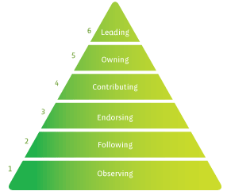
Individual Engagement Pyramid

Slide 13
Low Engagement
Consuming quality media
Educate yourself on the issues
Following an organization or rep on social media
Email lists
Notes:
Get on members’ mailing list
Cumulative!
Bottom pyramid is a good base/foundation

Slide 14
Medium Engagement
Filling out an action alert
Calling the offices of your elected officials
Write a letter to the editor
Using social media to advocate or educate
i.e. tagging your elected representatives with an advocacy message; sharing a fact sheet

Slide 15
High Engagement
Attend a town hall and ask a question
Meet with elected officials
Site visits
Testify before a legislative committee
Joining a government task force
Leading a protest/volunteer organizing activity

Slide 16
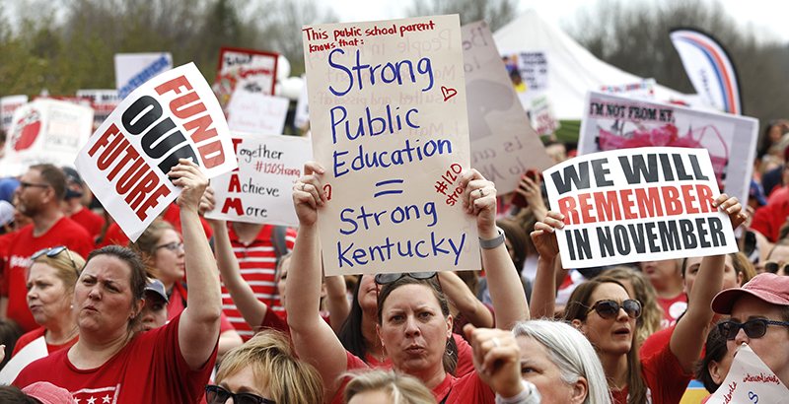
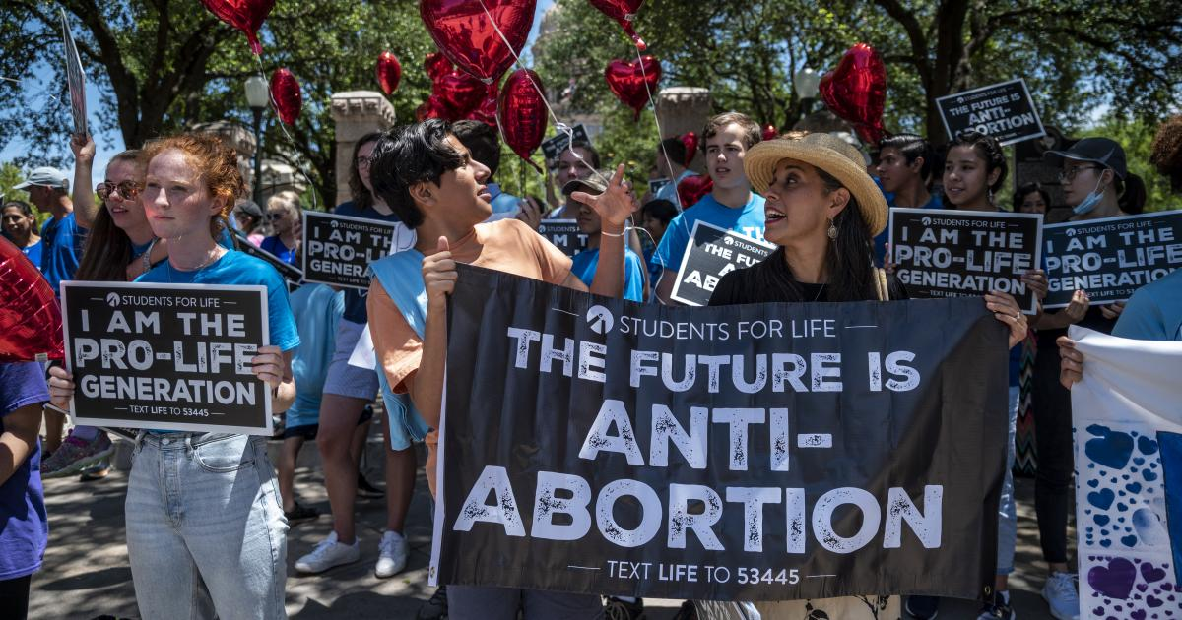
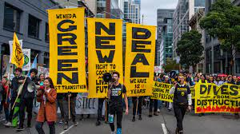

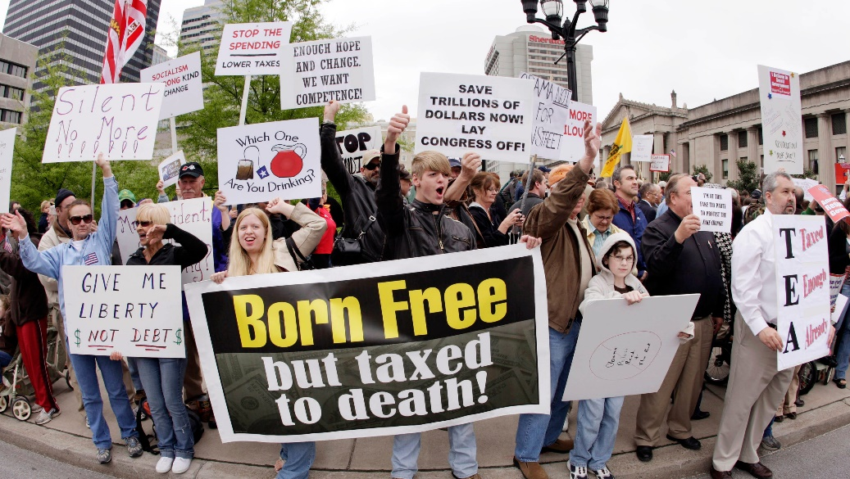

Examples of Organizations that do Grassroots Advocacy well?
Notes:
-unions
-gun groups
-abortion groups
-heritage foundation etc

Slide 17
“But How?”: Opportunities to Engage

Slide 18
Action Alert
Tweet at and write to your Members of Congress
Letter and tweets are advocating for: Foster Youth Mentoring Act, Youth Workforce Readiness Act, RISE from Trauma Act, Youth Mentoring Caucus
How can you support?: participate and share
mentoring.org/advocacy-august

Slide 19
Mayors for Mentoring
Strategy to build relationships with elected local officials
MENTOR is encouraging each affiliate and our grassroots network to nominate at least two new Mayors for Mentoring from their state
How can you support: Identify mayors and nominate
mentoring.org/mayors-for-mentoring

Slide 20
Additional Advocacy Resources
MENTOR provides a number of resources to help build your skills and get educated
Additional grassroots training and topic-specific
mentoring.org/resource/advocacy-resources

Slide 21
Tips for Giving Public Testimony
Who is the best deliverer of the message?
Make the policy personal
Check ahead of time to understand the public body’s rules
Keep your message concise (3-5 minutes as a rule of thumb)

Slide 22
Tips for Working with Elected Officials
What is your ask?
They’re people too!
Do your research
Include constituent voice
Make it easy for them
You don’t have to know all the answers
Follow up
Notes:
Know the bill number/sponsor. Why, etc.
Follow up: contact information and bulletpoints/leave behind materials

Slide 23
Action Items (do this right now!)
Send an action alert (e-mail and tweet)
Nominate a Mayor for Mentoring
Sign up for your member of Congress’ newsletter

Slide 24
Congressional Staff Q+A
Ken Brooke, Legislative Director, Rep. Mark Amodei (R-NV)
Faith Wilcox, Legislative Assistant, Rep. Mary Gay Scanlon (D-PA)
Notes:
Introduce yourself and describe your role within the congressional office. What does your day-to-day look like?
What information do you want/need from a grassroots advocate when they’re communicating with you?
Describe one really successful constituent meeting.
What is one way that your boss engages with constituents, or does a deeper dive on issues in your community?
What are the most effective communication strategies/tactics to get the attention of congressional offices/the staffers responsible for monitoring or flagging issues?

