Slide 1
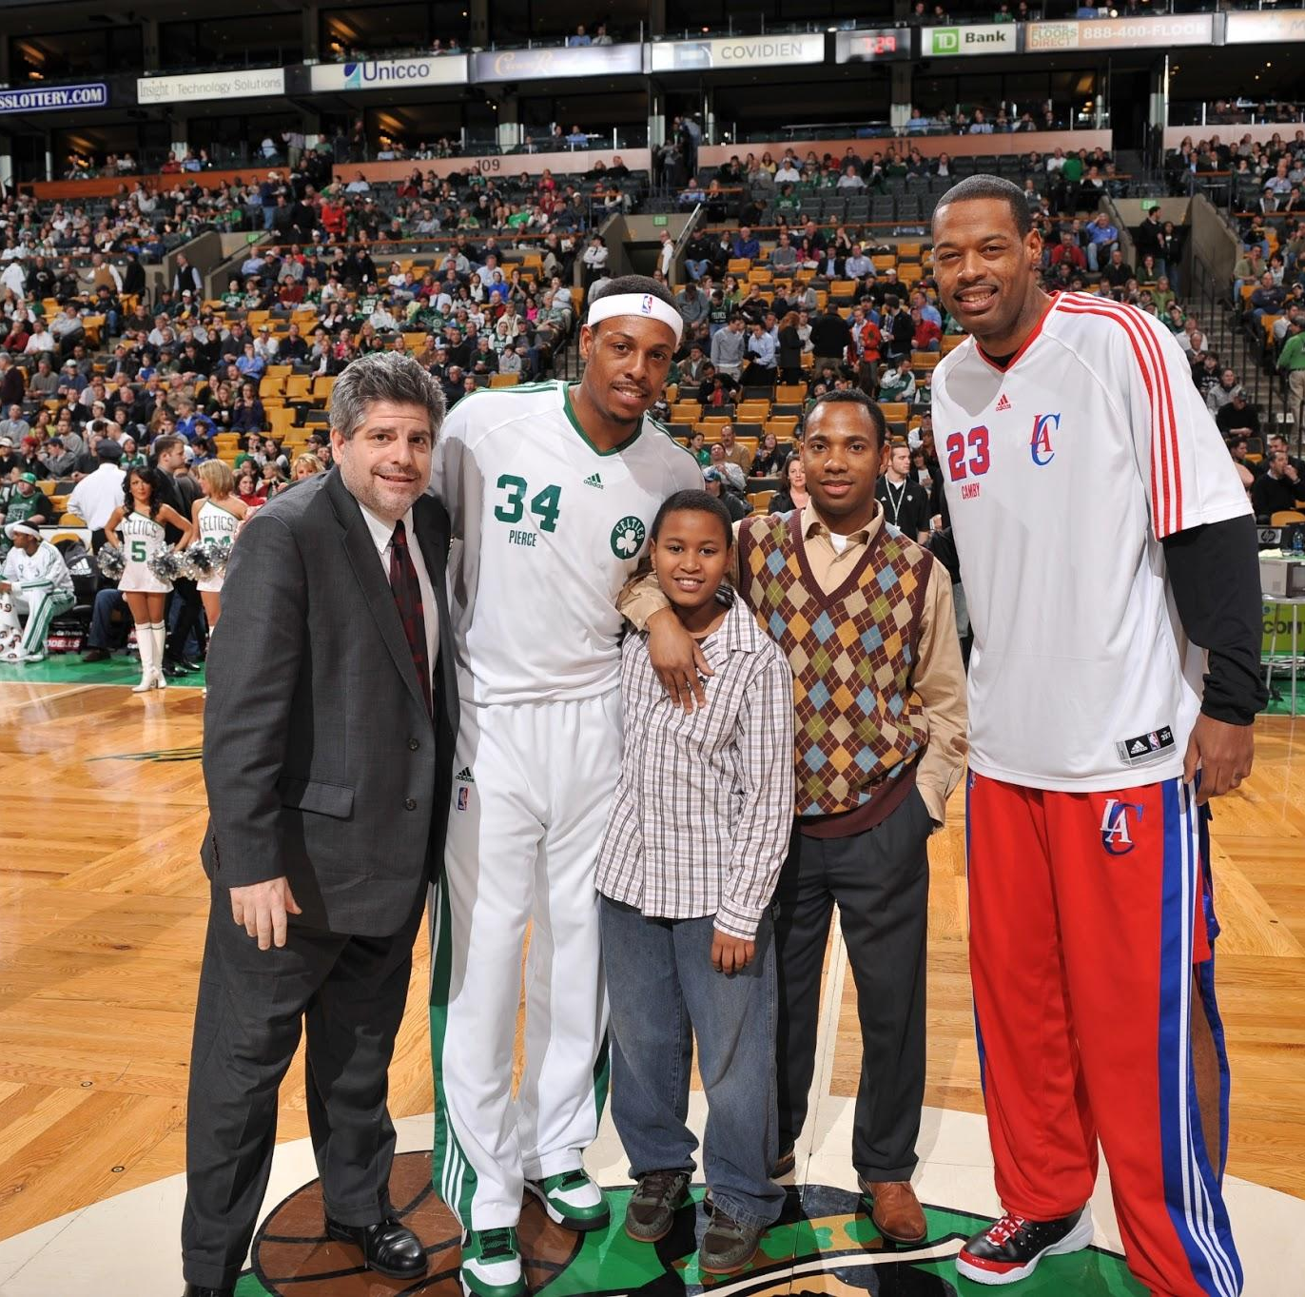
Creating Connection: Coaching to Support Youth

Slide 2

Who’s in the room?

Slide 3

ICE MELTER

Slide 4
Getting to know each other:
1. List all the groups that you belong to – or ways that you identify
2. Choose the top 5 – the most important parts of yourself
3. Divide the circle into 5 parts with each section of the circle equal to how much it is that you identify with that group
4. Introduce yourself to your partner by discussing the parts of you – making the whole

Slide 5


Slide 6
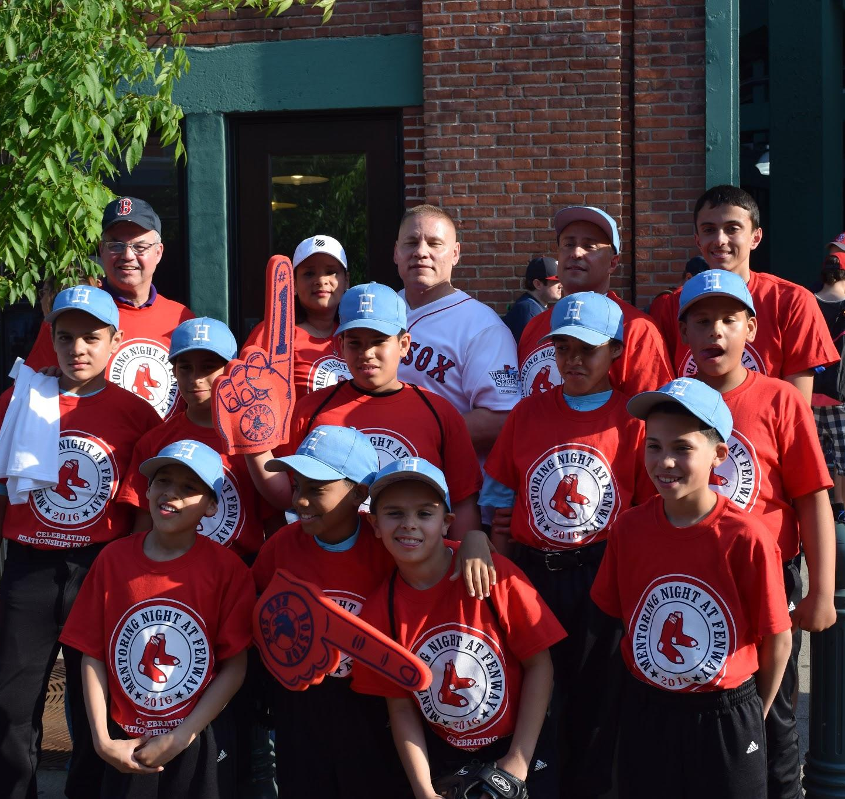
Think back:
Who was an adult who helped you out, had your back - served as a mentor in your life?
How did you meet this person?
What was it about them -what did they do, what qualities or characteristics did they have they helped out?
Notes:
https://www.ted.com/talks/adora_svitak?language=en#t-473414

Slide 7
The Power of Athletics to promote
Positive Youth Development
We know sports are beneficial for young people…
… But without an intentional focus on developmental outcomes through sport, young people may not get all the benefits that participating in sports has to offer

Slide 8

“Sport and physical activity provide an opportunity for youth to learn leadership in an enjoyable, motivating, and meaningful environment”
Notes:
“Participation in sport and physical activity-based positive youth development programs can foster a number of positive outcomes in youth” (168)
Quotes from page: 151

Slide 9
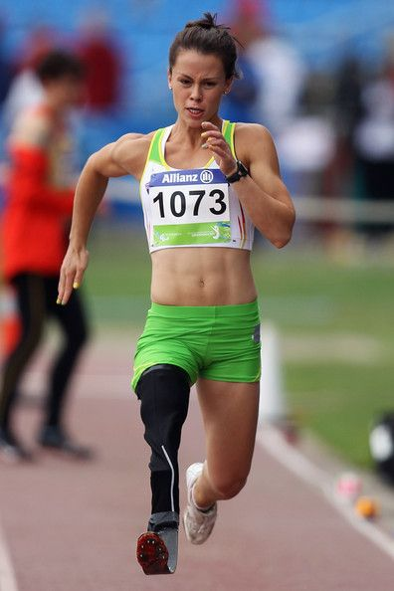
“...participation in such programs has the potential to develop and improve the interpersonal and intrapersonal skills of female youth such as leadership, confidence, self-esteem, self-worth, body image, and physical activity competence”
Notes:
Quotes from page: 169
Based on

Slide 10
“The youth also identified specific opportunities that the program provided to enable transference of life skills they learned in their village, becoming a referee or time keeper, and participating in an active recess program at school to minimize bullying.”
Notes:
Quotes from page: 173
Based on a hockey development program in Canada for First Nation, Metis, and Inuit Youth

Slide 11
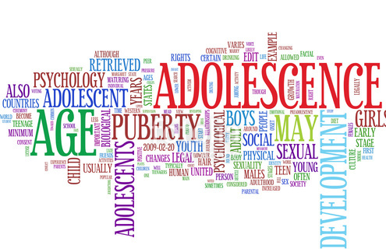

Slide 12
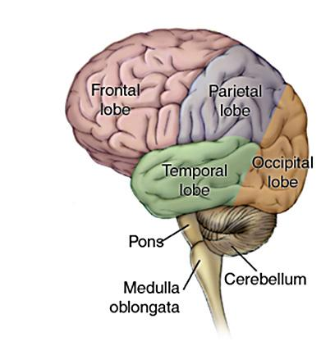
What is really going on in the brain?

Slide 13

THE TEEN BRAIN

Slide 14
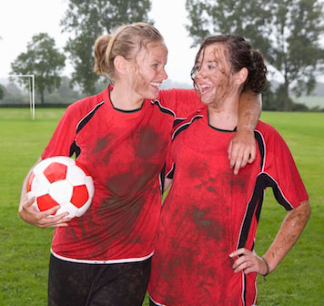
“……hard science demonstrates that teenagers and young adults are not fully mature in their judgment, problem-solving and decision-making capacities…”
According to the JJDPA Fact Book/Adolescent Brain Development and Juvenile Justice Fact Sheet

Slide 15
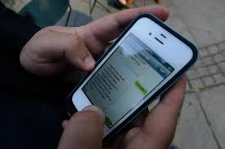
Jordan’s Decision

Slide 16
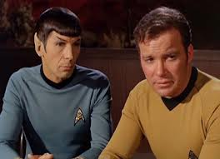
Who’s making the decision?

Slide 17
Emotional Brain | Rational Brain
I can’t miss out | I made a commitment to the team
Krystal may be interested in me | I am a good player and the team may need me
I may never have this opportunity again | I could go hang out after work or on the week-end
This is going to be the best night of the summer – and I will miss it | What would my coach think if I just skipped out on the game – He has higher expectations of me
No one will miss me at the game – we have too many players anyway | I could mess up this chance for a day with my friends – doesn’t sound right

Slide 18

SO. . . . . What’s a coach to do?

Slide 19

Performance-Based Sports Development | Sports-Based Youth Development
Focused on improving performance | Focused on growing competence, confidence, caring/compassion, character, connection, and community in young people

Slide 20

“Developmental relationships are close connections that powerfully and positively shape young people’s identities and help them develop thriving mindsets”

Slide 21


Youth Voice
https://www.youtube.com/watch?v=vpFG6mNAkAc
Notes:
How do the findings in Don’t Quit on Me reinforce or challenge what you believe about young people who interrupt their high school education? What surprised you?
What are the formal and informal ways that young people encounter supportive relationships in your school?
How could you and your colleagues make these kinds of encounters more intentional and more frequent?
Moving homes and changing schools can be disruptive to success in high school. How do you welcome new students to your school or your classroom?
Suspension and expulsion are among the statistically significant threats to graduation. How are students in your school affected by these? What steps could you take to reduce the incidence of exclusionary discipline?
What relationship does your school have with community-based organizations or public agencies that can provide support to students who are affected by one or more of the adverse circumstances listed at right?
How could your school shift how you use existing community and school resources to provide more academic or social support to young people?

Slide 22

What did you hear?
Notes:
How do the findings in Don’t Quit on Me reinforce or challenge what you believe about young people who interrupt their high school education? What surprised you?
What are the formal and informal ways that young people encounter supportive relationships in your school?
How could you and your colleagues make these kinds of encounters more intentional and more frequent?
Moving homes and changing schools can be disruptive to success in high school. How do you welcome new students to your school or your classroom?
Suspension and expulsion are among the statistically significant threats to graduation. How are students in your school affected by these? What steps could you take to reduce the incidence of exclusionary discipline?
What relationship does your school have with community-based organizations or public agencies that can provide support to students who are affected by one or more of the adverse circumstances listed at right?
How could your school shift how you use existing community and school resources to provide more academic or social support to young people?

Slide 23

Express
Care
Expand Possibilities
Provide Support
Share Power
Challenge Growth

Slide 24
Adults are dependable: spend time
Adults listen
Adults believe in young people
Adults are warm: showing that they enjoy spending time with young people
Adults encourage: praise young people for their effort and accomplishments
Express
Care

Slide 25
Provide Support
Adults navigate: guiding young people through hard situations and systems
Adults empower: build young people’s confidence
Adults advocate on behalf of young people
Adults set boundaries: putting in place limits that keep them on track

Slide 26
Challenge Growth
Adults expect the best of young people
Adults stretch: push young people to go further
Adults hold young people accountable
Adults help young people reflect on failures

Slide 27
Adults respect young people: taking them seriously and treating them fairly
Adults include young people: involving them in the decisions that affect them
Adults collaborate with young people: working with them to solve problems and reach goals
Adults let young people lead
Share Power

Slide 28
Adults inspire young people to see possibilities
Adults broaden horizons exposing them to new ideas, experiences and places
Adults connect young people to others who can help them develop and thrive
Expand Possibilities

Slide 29
Express
Care
Expand Possibilities
Provide Support
Share Power
Challenge Growth

Slide 30


Slide 31

Lisa’s Story
More about Samuel

Slide 32

Experience(s) that threaten the physical, emotional, mental and spiritual well being of a child/adolescent or of someone critically important to the child/adolescent
Frightening, chaotic, unpredictable, overwhelming, loss of power/control, helplessness
Notes:
Common trauma responses
Brainstorm
On edge,” easily startled
Withdrawn, avoidant, seem “numb”
Increased aggression
Difficulty concentrating, impulsive
Changes in appetite
Difficulty with forming trusting relationships
“Triggers” – something (e.g. sound, smell, situation) that is a reminder of traumatic experience, causes distress

Slide 33
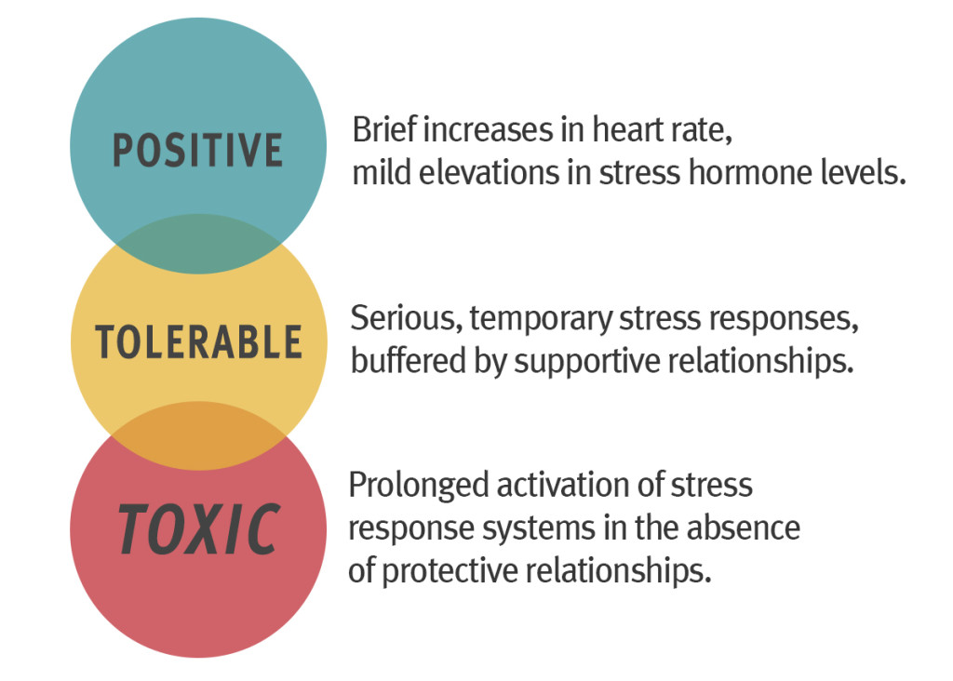
Positive stress helps us grow.
Toxic stress = trauma
Source: Center on the Developing Child, Harvard University

Slide 34
Potential traumatic stress responses in young people
“On edge,” easily startled
Withdrawn, avoidant, seem “numb”
Increased aggression
Difficulty concentrating, impulsive
Changes in appetite
Difficulty with forming trusting relationships
“Triggers” – something (e.g. sound, smell, situation) that is a reminder of traumatic experience, causes distress
Notes:
VJS
HANDOUT
Remember these responses are adaptive--often ways to cope with or make sense of overwhelming situations
They may not make sense from the outside, but when you take into consideration the role of trauma, they do make sense.
For those interested we can send out the Amazing Brain which explains this more in-depth.
***note: not every child showing these responses has trauma, but something to consider, it won’t do harm to be mindful of that possibility, considering how common (as we saw in last slide).

Slide 35
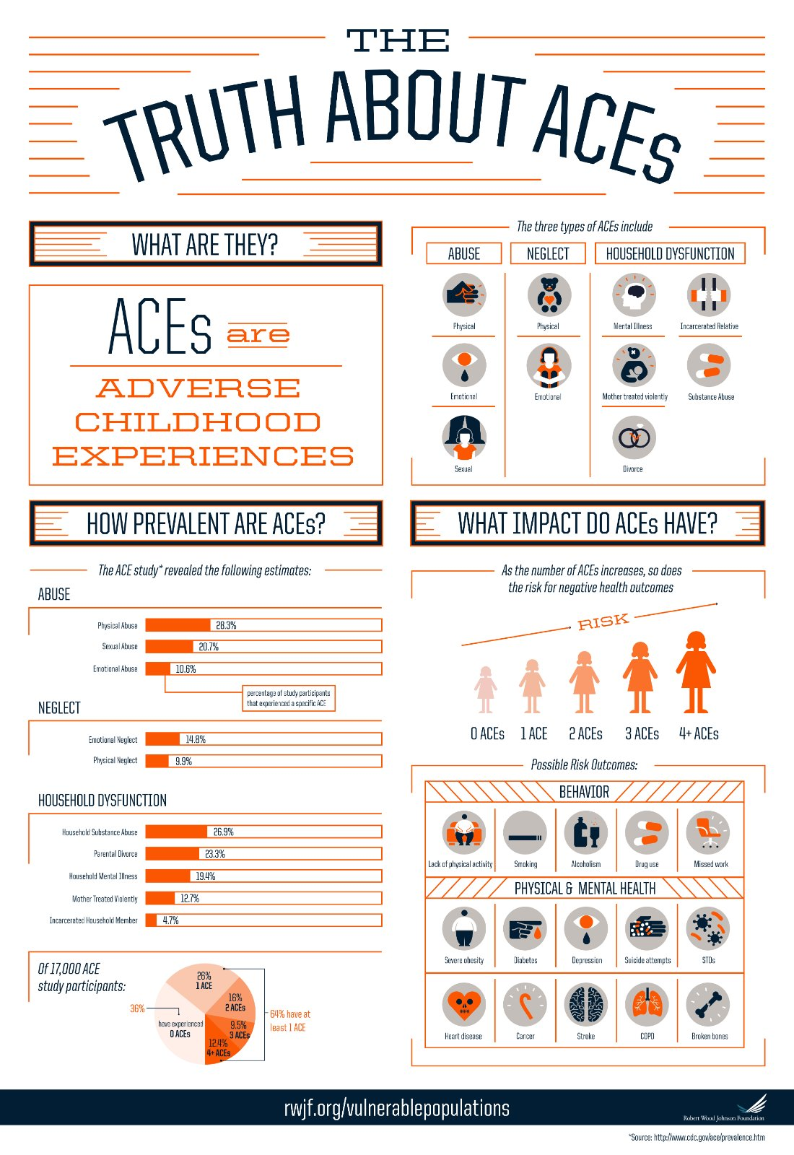
Notes:
Adverse childhood experiences (ACEs) are potentially traumatic events that can have negative, lasting effects on health and well-being.¹ These experiences range from physical, emotional, or sexual abuse to parental divorce or the incarceration of a parent or guardian.

Slide 36
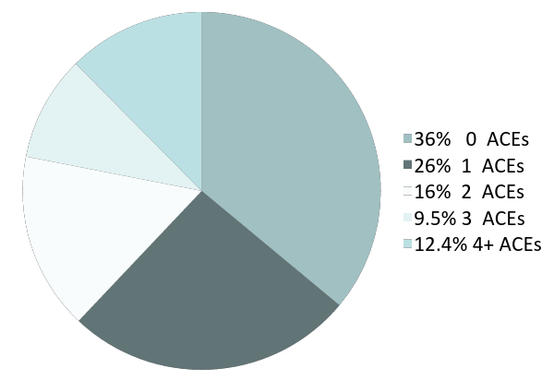
OF 17,000 ACE Study Participants:
12.4 %
4+ ACEs
9.5%
3 ACEs
36%
0 ACEs
16%
2 ACEs
26%
1 ACEs
64% have at least 1 ACE

Slide 37
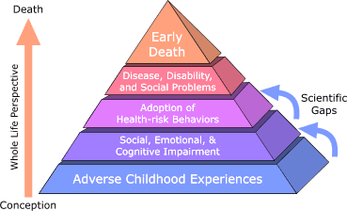

Slide 38
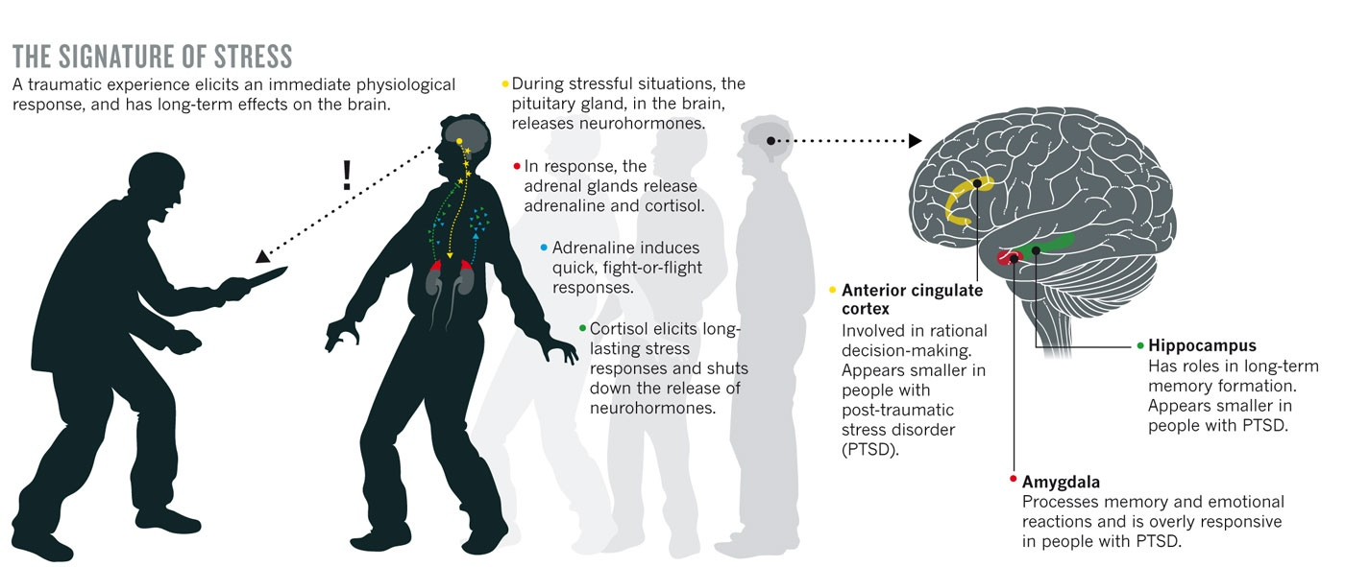
Brain Stress Response
Notes:
-Trauma forces us to spend more of our time in the instinctual part of our brain.
-More energy can be spent in this section versus in allowing other parts of our regular functions to develop.
Doesn’t sound like a huge deal, but all of the great and important connections and growth that would happen as part of a childs or adolescents development can get stopped.
Remember to that the brain is where everything happens. We associate it with our thinking, but it’s our ability to interpret speech, to regulate and interpret emotion, to coordinate or motion and senses – so much energy can be diverted away from a postive healthy development of the brain.
Imagine a young person whose experienced significant trauma trying to sit still in a classroom and learn. When you very regularly don’t feel safe, or are on edge, or feeling numb – or feeling as though you have to fight or flee. This is extremely difficult.

Slide 39
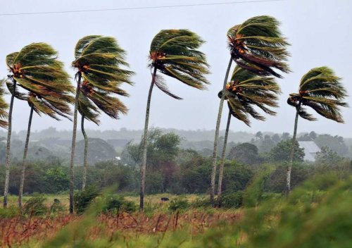
Resilience is the capacity of individuals and communities to adapt, survive, and bounce back in the midst of hardship and adversity
Notes:
Positive Youth Development is a model/approach that recognizes that all young people have assets and that through relationships with caring adults, those assets can be increased. For youth who have experienced trauma, using this model/approach is particularly important, which is why it is one of the Trauma-Informed Principles
Young people come with strengths and assets and we want to focus on those things
Youth with trauma may have a hard time seeing their own strengths
-We’re going to get more into resilience throughout the training

Slide 40

Neuroplasticity and the Brain
https://www.youtube.com/watch?v=ELpfYCZa87g
Notes:
https://www.youtube.com/watch?v=ELpfYCZa87g

Slide 41
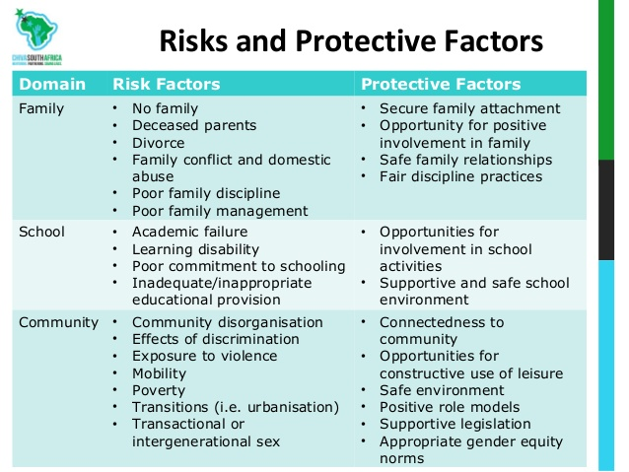
Factors that Influence Resiliency

Slide 42

Back Pack Revisit

Slide 43
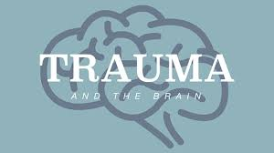
Trauma Informed Practices

Slide 44
Principles of Trauma Informed Care
Positive Relationships
Understanding Trauma and it’s Impact
Culture of Self – Care
Promoting Safety
Voice and Choice
Access to Resources
Cultural Competence and Promotion of Equity
Social Emotional Learning

Slide 45
What will you do next?
Action Planning

