Slide 1
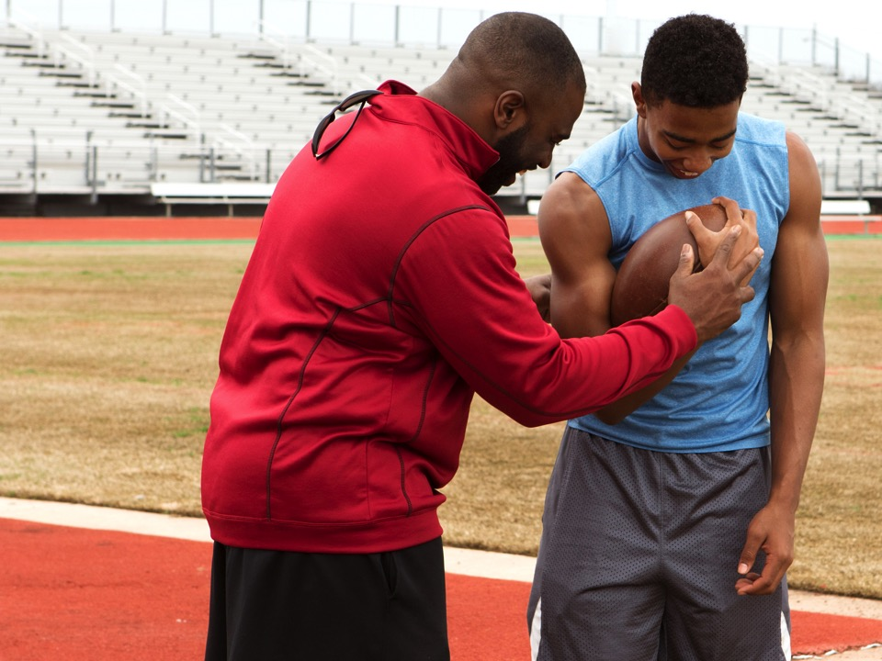
Creating Connection
Coaching to Support Youth
Workbook

Slide 2

Five Things About Me:
1)
2)
3)
4)
5)
TODAY’S TRAINING
Think about the ways in which relationships help drive the learning between coaches and players
Explore the Developmental Relationships Framework for helping youth thrive
Practice some tangible strategies so coaches can put this framework into action

Slide 3
Which of these outcomes is the most important thing that you learned from sports?
1
6
2
7
3
8
4
9
5
10
“Sport and physical activity provide an opportunity for youth to learn leadership in an enjoyable, motivating and meaningful environment”
“…participation in such program has the potential to develop and improve the interpersonal and intrapersonal skills of female youth such as leadership, confidence, self-esteem, self-worth, body image, and physical activity competence”
“The Youth also identified specific opportunities that the program provided to enable transference of life skills they learned in their village, becoming a referee or time keeper, participating in an active recess program at school to minimize bullying”
Participation in sports leaders to: fewer dietary problems, declines in mental health issues, less suicidal thoughts lower levels of emotional distress, increase in physical activity levels, academic attainment, time-management skills, emotional regulation, self-esteem and positive self-image.
Positive Youth Development Through Sport edited by Nicholas L Holt

Slide 4
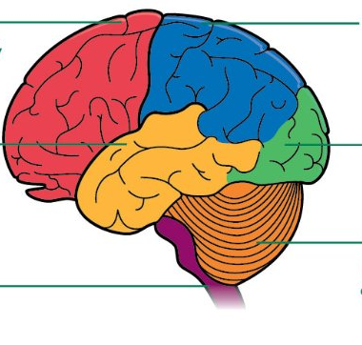
COACHING FRAMEWORK
THE BRAIN

Slide 5
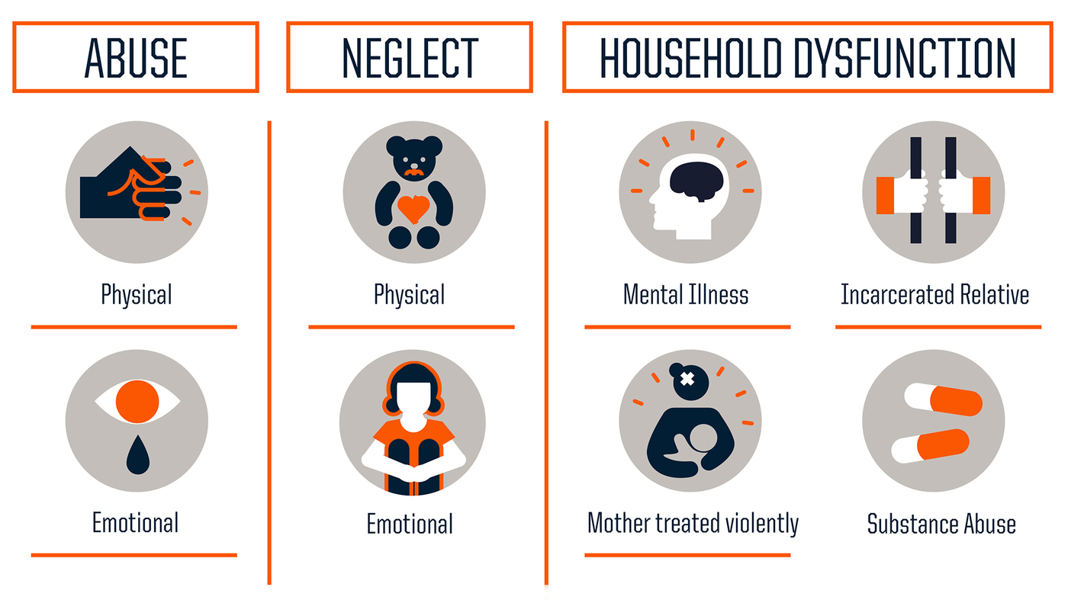
WHO’S COMING TO PLAY?
THEIR BODIES
THEIR TEAM
THEIR FEELINGS

Slide 6


Youth Report:

Slide 7


Slide 8

“Developmental relationships are close connections that powerfully and positively shape young people’s identities and help them develop thriving mindsets”

Slide 9
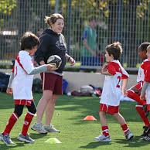
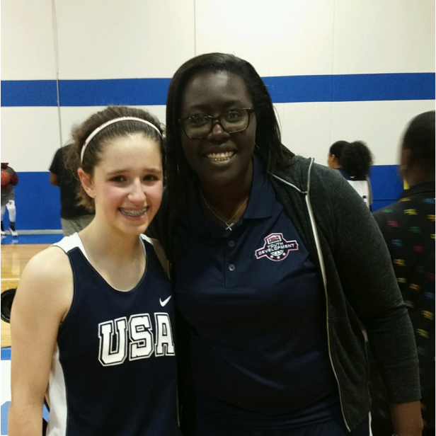
Express Care
Provide Support

Slide 10
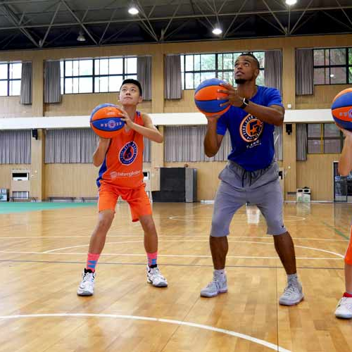
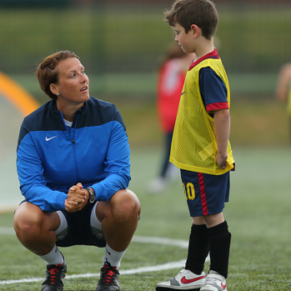
Challenge Growth
Share Power

Slide 11
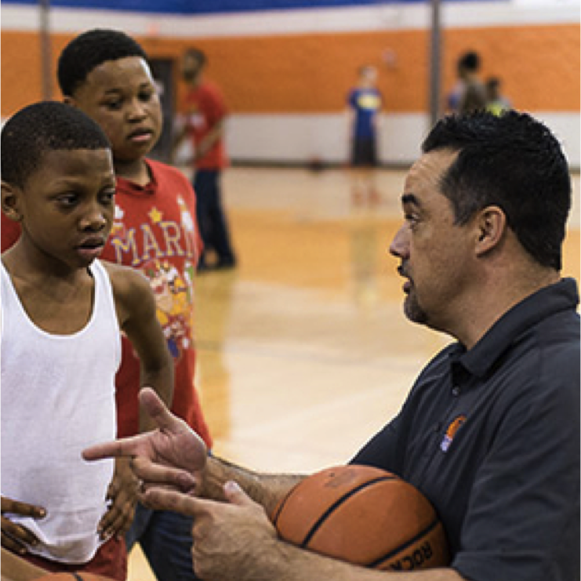
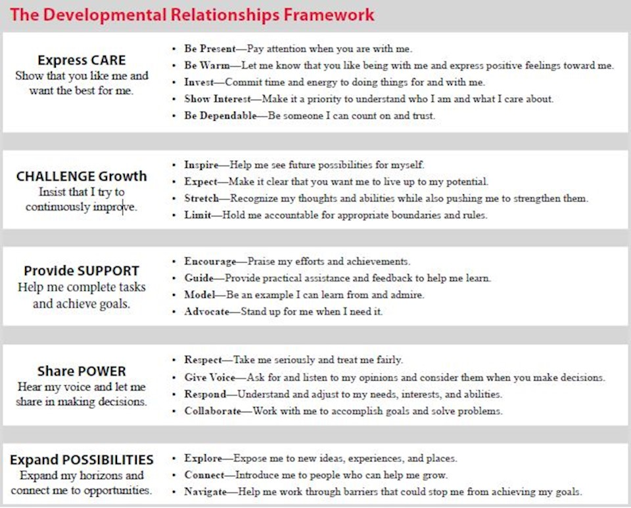
Expand Possibilities

Slide 12
 | COACHES SAY | COACHES DO | FOR THE TEAM
EXPRESS CARE
PROVIDE SUPPORT
CHALLENGE GROWTH
SHARE POWER
EXPAND POSSIBILITIES

Slide 13
 | COACHES SAY | COACHES DO | FOR THE TEAM
EXPRESS CARE | I see you | Offer specific praise | Facilitate informal time
PROVIDE SUPPORT | I believe | Focus on progress, not performance | Practice positive traditions
CHALLENGE GROWTH | How did you do that? | Coach in questions | Coach in question
SHARE POWER | You be the coach | Create opportunities for contribution | Huddle up and listen
EXPAND POSSIBILITIES | What’s Next? | Use your team | Use your team

